Slide 1
Design and Analysis of Algorithms CS345
Lecture 36
Fibonacci Heap
Stable Matching Problem
Finishing touch …

Slide 2
Fibonacci Numbers
Revising Discrete math

Slide 3







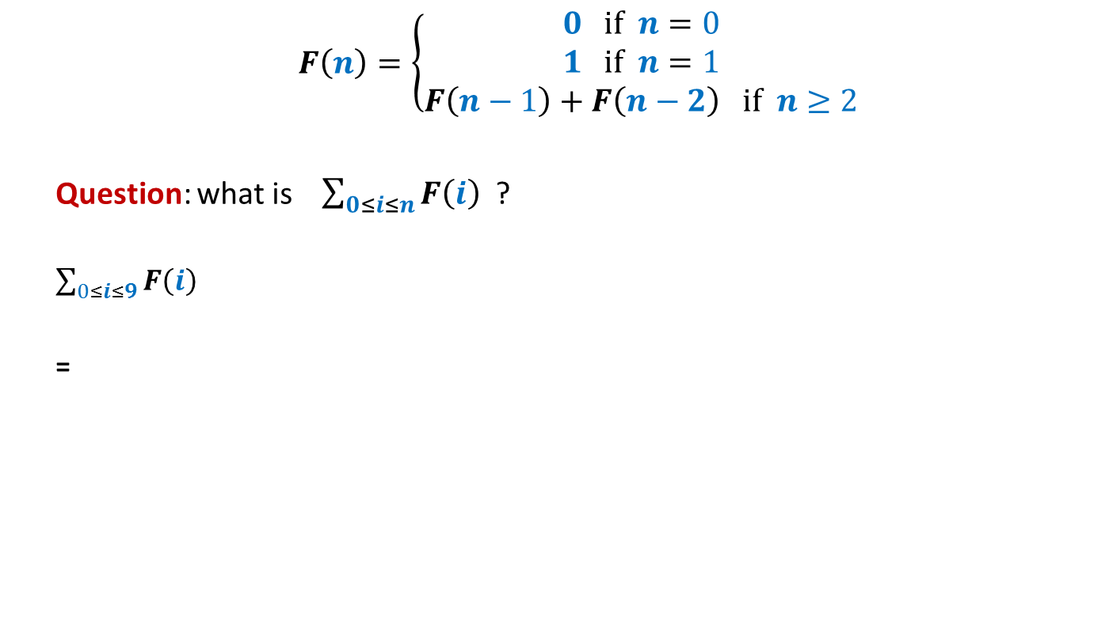














$$F\left(n\right)=\left\{\begin{aligned}0 if n=0 \\ 1 if n=1 \\ F\left(n−1\right)+F\left(n−2\right) if n≥2\end{aligned}\right.$$
Question: what is $\sum_{0≤i≤n}{F\left(i\right)}$ ?
$\sum_{0≤i≤9}{F\left(i\right)}$
=
$$=F\left(n+2\right)−1$$
$1$+
$$F\left(10\right)$$
+ $F\left(8\right)$
+ $F\left(7\right)$
+ $F\left(6\right)$
+ $F\left(5\right)$
+ $F\left(4\right)$
+ $F\left(3\right)$
+ $F\left(2\right)$
+ $F\left(1\right)$
$$F\left(11\right)$$
$$F\left(9\right)$$
+ $F\left(9\right)$
+ $F\left(8\right)$
+ $F\left(7\right)$
+ $F\left(6\right)$
+ $F\left(5\right)$
+ $F\left(4\right)$
+ $F\left(3\right)$
+ $F\left(2\right)$
We can use this to get an alternate expression for Fibonacci numbers ☺

Slide 4

$$F\left(n\right)=\left\{\begin{aligned}0 if n=0 \\ 1 if n=1 \\ 1+\sum_{0≤i≤n−2}{F\left(i\right)} if n≥2\end{aligned}\right.$$

Slide 5

Decrease-key($H$,$x$,$Δ$) in Fibonacci heap (using Cascaded-cuts)

Slide 6
Decrease-key($H$,$x$,$Δ$) in Fibonacci heap (using Cascaded-cuts)

Slide 7


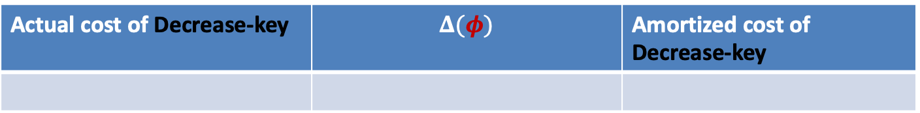


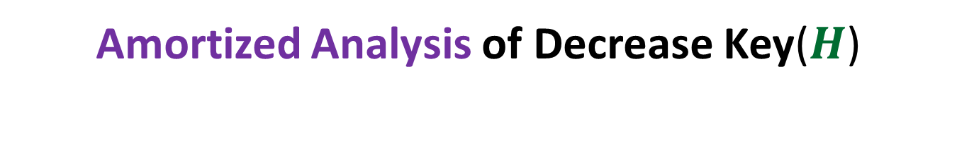



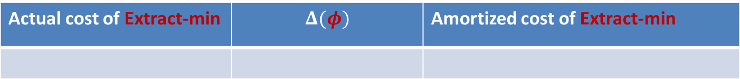


Amortized Analysis of Decrease Key($H$)
$φ$($H$): $c$ $t(H)$
$$+ 2c m(H)$$
$m(H)$: the number of marked nodes
Actual cost of Decrease-key | $$Δ(φ)$$ | Amortized cost of Decrease-key
$cm(H_{old})−cm(H_{new})$ + $c$
$cm\left(H_{new}\right)−cm(H_{old})$ $+$ $c$
$$2c$$
Actual cost of Extract-min | $$Δ(φ)$$ | Amortized cost of Extract-min
$$c t(H_{old})$$
$$≤c(log n − t\left(H_{old}\right))$$
$$c(log n)$$

Slide 8

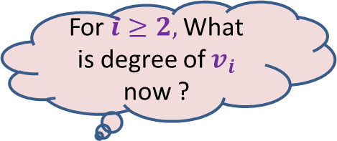






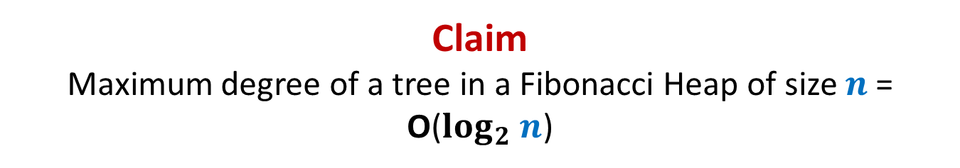









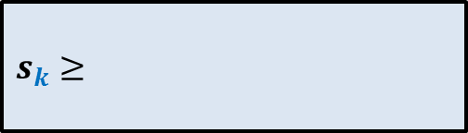

Claim Maximum degree of a tree in a Fibonacci Heap of size $n$= O($log_{2} n$)
This is equivalent to …
$s_{k}$ : the minimum size of a tree rooted at node of degree $k$
Recurrence for $s_{k}$ = ?
“For a node $x$of degree $k$ , size($x$) is $Ω(a^{k})$ always”
For $i≥2,$What is degree of $v_{i}$ now ?
What is degree of $v_{1}$ now?
$$≥i−2$$
$$≥0$$
$$x$$
Arrange the children of $x$ in the increasing order of time of becoming children of $x$.
At the time of becoming child of $x$, degree of $v_{i}≥i−1$. From that moment till now, $v_{i}$can lose at most one child.
…
…
$$k i 2 1$$
$$v_{k}$$
$$v_{i}$$
$$v_{2}$$
$$v_{1}$$
$s_{k}≥$
$$s_{0}=1$$
$$+ \sum_{2≤i≤k}{s_{i−2}}$$
$$1$$
$$+ 1$$
$$s_{1}=2$$

Slide 9
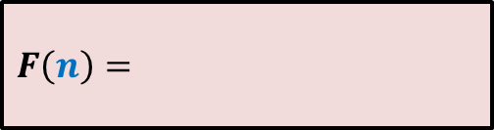








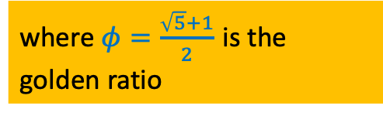




$$s_{0}=1$$
$$F(0)=0$$
$$s_{1}=2$$
$$F(1)=1$$
$F\left(n\right)=$
$s_{k}≥$
$$1+\sum_{0≤i≤n−2}{F\left(i\right)}$$
$$+ \sum_{0≤i≤k−2}{s_{i}}$$
$$1$$
$$+ 1$$
$$s_{k} ≥ F(k)$$
In fact, …
Obvious
$$F(k+2)$$
$$≥φk$$
where $φ=\frac{\sqrt{5}+1}{2}$ is the golden ratio

Slide 10


















Mission accomplished ☺
 | Binary heap
Binomial heap
Binomial heap
Fibonacci heap
Find-min($H$)
O($1$)
O($\log{n}$)
O($1$)
O($1$)
Insert($H$, $x$)
O($\log{n}$)
O($\log{n}$)
O($1$)
O($1$)
Extract-min($H$)
O($\log{n}$)
O($\log{n}$)
O($\log{n}$)
O($\log{n}$)
amortized
amortized
Decrease-key($H$,$x$,$y$)
O($\log{n}$)
O($\log{n}$)
O($\log{n}$)
O($1$)
amortized
Merge-heaps($H_{1}$,$H_{2}$)
O($n$)
O($\log{n}$)
O($1$)
O($1$)
Fibonacci Heaps were invented in 1985 by Fredman and Tarjan.

Slide 11
Stable Marriage Problem

Slide 12







Stable Marriage Problem
Women
Men
$$w_{1}$$
$$m_{1}$$
$$3$$
…
$$w_{2}$$
$$m_{2}$$
$$1$$
…..
$$w_{3}$$
$$m_{3}$$
$$2$$
$$w_{i}$$
$$m_{j}$$
$$w_{n}$$
$$m_{n}$$

Slide 13



Stable Marriage Problem
Women
Men
$$w_{1}$$
$$m_{1}$$
$$3$$
$$w_{2}$$
$$m_{2}$$
…
…
$$1$$
$$w_{3}$$
$$m_{3}$$
…..
$$2$$
$$k$$
$$w_{i}$$
$$m_{j}$$
$$w_{n}$$
$$m_{n}$$

Slide 14
Stable Marriage Problem
Women
Men
Marriage : ?
$$w_{1}$$
$$m_{1}$$
$$w_{2}$$
$$m_{2}$$
$$w_{3}$$
$$m_{3}$$
…
…
$$w_{i}$$
$$m_{j}$$
…
…
$$w_{n}$$
$$m_{n}$$
a bijection between Women and Men

Slide 15

Stable Marriage Problem
Meaning of unstability
Women
Men
$w_{l}$ prefers $m_{j}$ to $m_{k}$
$m_{j}$ prefers $w_{l}$ to $w_{i}$
Definition:
A marriage is said to be stable if there is no unstable pair in the society.
($w_{l}$, $m_{j}$) : an unstable pair
$$w_{l}$$
divorce
$$m_{k}$$
$$w_{i}$$
divorce
$$m_{j}$$

Slide 16
Stable Marriage Problem
$M$ : set of $n$men
$W$ : set of $n$women
For each man $m∈M$,
$L(m)$: a preference list of all women
For each woman $w∈W$,
$L(w)$: a preference list of all men
Aim: To compute a stable marriage.

Slide 17
Algorithm for Stable Marriage
1962, David Gale and Lloyd Shapley
Man proposes
Woman disposes

Slide 18


Stable Marriage Problem
Women
Men
$$w_{1}$$
$$m_{1}$$
$$2$$
$$w_{2}$$
$$m_{2}$$
$$1$$
$$w_{3}$$
$$m_{3}$$
$$1$$
$$1$$
$$w_{i}$$
$$m_{j}$$
$$w_{n}$$
$$m_{n}$$

Slide 19
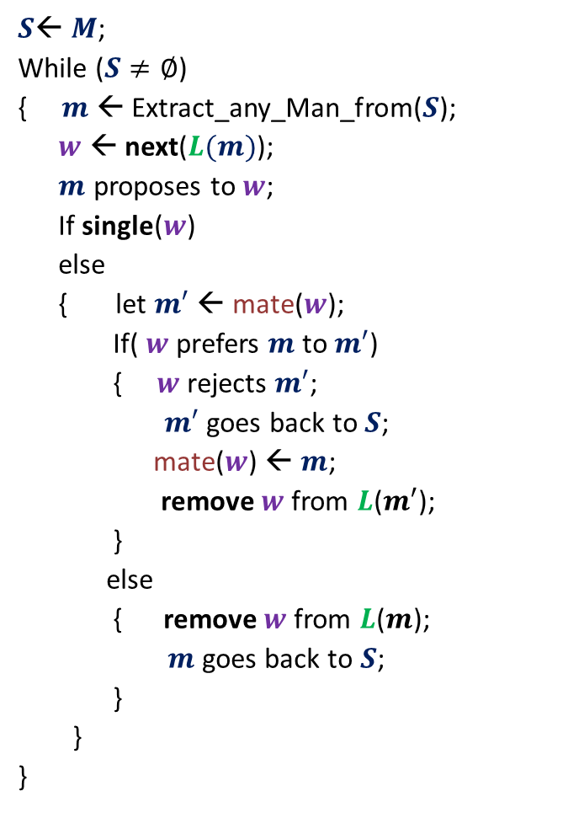
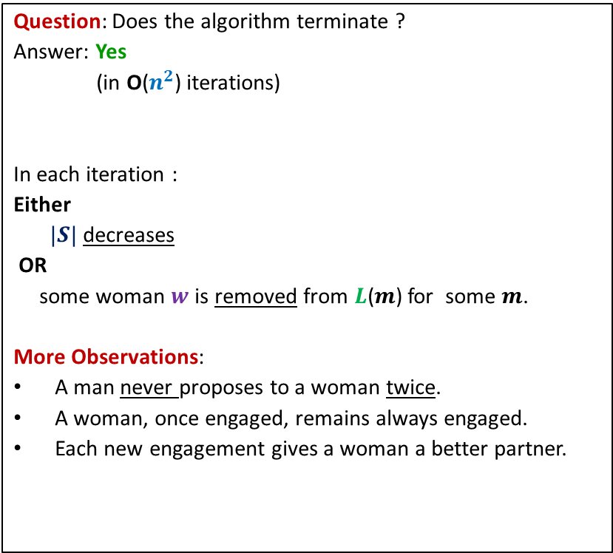
GaleShapley($M$, $W$)
$S$← $M$;
While ($S≠∅$)
{ $m$← Extract_any_Man_from($S$);
$w$ ← next($L(m)$);
$m$ proposes to $w$;
If single($w$)
else
{ let $m′$ ← mate($w$);
If( $w$ prefers $m$ to $m′$)
{ $w$rejects $m′$;
$m′$ goes back to $S$;
mate($w$) ← $m$;
remove $w$from $L$($m′$);
}
else
{ remove $w$from $L$($m$);
$m$ goes back to $S$;
}
}
}
Question: Does the algorithm terminate ?
Answer: Yes
(in O($n^{2}$) iterations)
In each iteration :
Either
$|S|$ decreases
OR
some woman $w$is removed from $L$($m$) for some $m$.
More Observations:
A man never proposes to a woman twice.
A woman, once engaged, remains always engaged.
Each new engagement gives a woman a better partner.
mate($w$) ← $m$;
Any measure of progress ?
in list $L(w)$, $m$precedes $m′$)

Slide 20
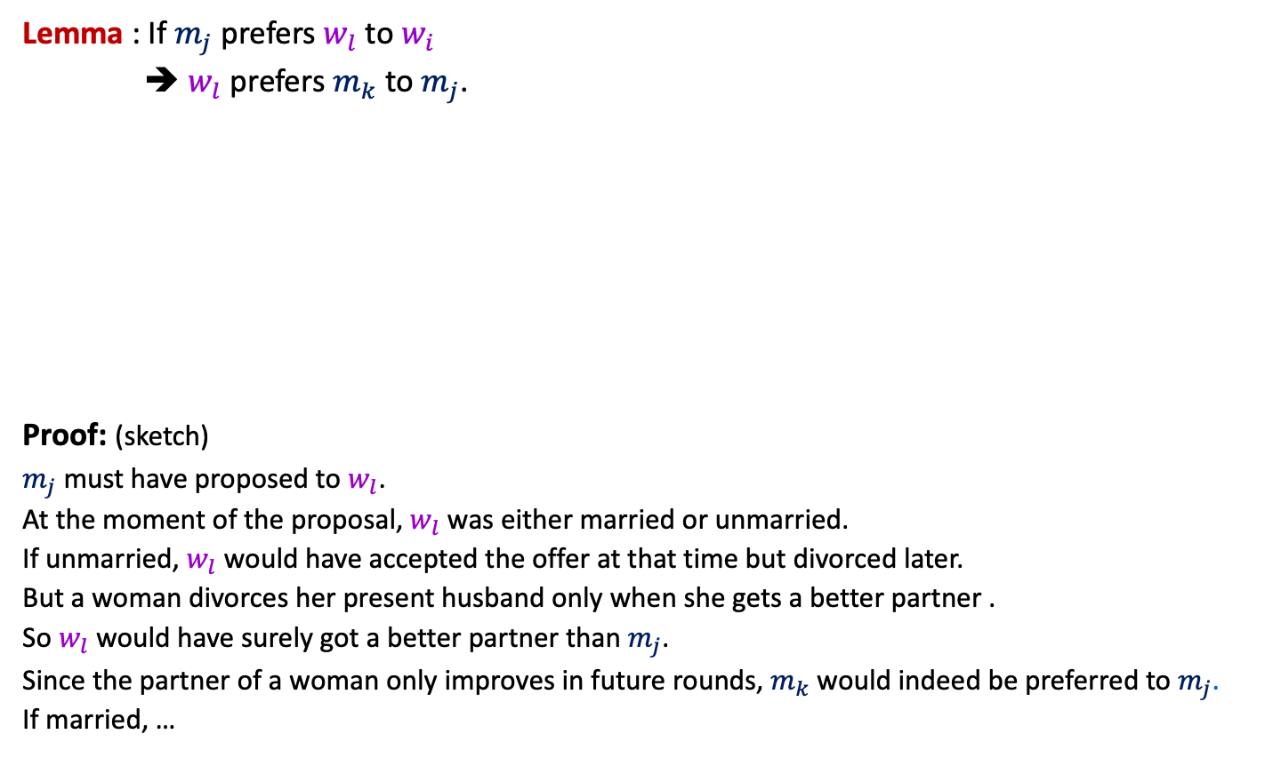
GaleShapley($M$, $W$) (Proof of stability)
Lemma : If $m_{j}$ prefers $w_{l}$ to $w_{i}$
➔ $w_{l}$ prefers $m_{k}$ to $m_{j}$.
Proof: (sketch)
$m_{j}$ must have proposed to $w_{l}$.
At the moment of the proposal, $w_{l}$ was either married or unmarried.
If unmarried, $w_{l}$ would have accepted the offer at that time but divorced later.
But a woman divorces her present husband only when she gets a better partner .
So $w_{l}$ would have surely got a better partner than $m_{j}$.
Since the partner of a woman only improves in future rounds, $m_{k}$would indeed be preferred to $m_{j}$.
If married, …
$$w_{l}$$
$$m_{k}$$
$$w_{i}$$
$$m_{j}$$

Slide 21
GaleShapley($M$, $W$)
Theorem:
GaleShapley($M$, $W$) indeed computes a stable marriage.
Question : Does there exist a unique stable marriage ?
Answer: No.

Slide 22
Stable Marriage Problem
Women
Men
$$w_{1}$$
$$m_{1}$$
$$w_{2}$$
$$m_{2}$$
proposal
proposal
$$w_{3}$$
$$m_{3}$$
$$w_{n}$$
$$m_{n}$$
Men Optimal
Women Pessimal
Women Optimal
Men Pessimal

Slide 23


Gale-Shapley($M$, $W$) (Proof of man-optimality)
What is the assertion whose proof will establish
man-optimality ?
This proof is for fun only.
It won’t be asked in any exam or assignment
Assertion:
Let $m$ be any man married to woman $w$ after the algorithm.
If $w′$ is a woman that man $m$ prefers to $w$,
Then there can not be any stable marriage in which $m$ is married to $w′$.
We will prove this next class.

